Slide 1
Data Provisioning Using SAP DS

Slide 2
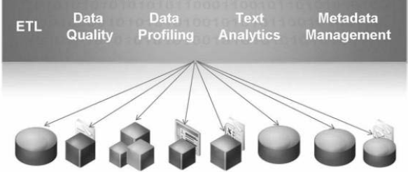
SAP Data Services
Suitable to perform a large number of transformations to the data.
One Stop Solution for Information Management.
Extract, transform, and load data into a data warehouse to create a complete view.
Useful to unlock meaning from unstructured documents with native text data processing

Slide 3
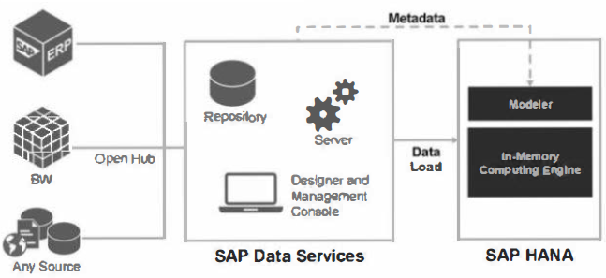

Slide 4
SAP DS - Advantages
SAP HANA repository support
SAP HANA performance Improvements
Bulk updates enhancement
transparent staging table for bulk loading to targets
Support for stored procedures
Data streaming in ABAP data flows
New data transfer method - RFC
eliminates the need for intermediate data files and also provides the ability to adjust the data transfer package size.
SAP table reader In regular data flows
can now fetch data in batch from an SAP system
allows the reader to process large volumes of data and mitigates out-of-memory errors.
Parallel reading from business content extractors
supports multithreading for SAP extractors
New ABAP functions for Improved security

Slide 5
Full extractor support through Operational Data Provider data replication API
API is installed on the SAP Net Weaver Platform.
ODP provides the following benefits in Data Services:
Ability to browse all available "released“ extractors (certified for ODP).
Customer can release generic extractors using transaction RODPS_OS_EXPOSE
Extract data in both initial and changed-data capture (delta) mode
Stream data from the SAP application to the data flow without using staging files.

Slide 6
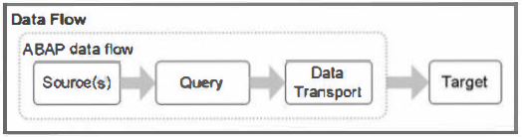
ABAP Dataflow
ABAP Data Flow will generate an ABAP program according to the fields which you have selected from SAP tables
The ABAP program is then copied onto the SAP server
SAP executes this program, collects all the data from tables and creates a file in the SAP Work Directory with the name you maintained in Data Transport object in the ABAP Data Flow. This file stores the data.
Then with the help of Data Transfer Methods, system wiII move the file from SAP Work Directory to BODS Job Server local directory. Then the normal Data Flow will take that file as source to read and then loads to target table.

Slide 7
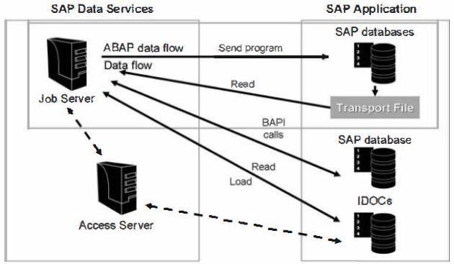
Standard vs ABAP Dataflows
Standard Dataflow can be used if you have the following requirements:
reading a single table
small number of columns
ABAP Dataflow can be used if you have the following requirements:
reading multiple ECC tables
push down any join operations to the SAP Application
better performance
It is recommended to use ABAP dataflows when loading data from SAP Applications.

Slide 8
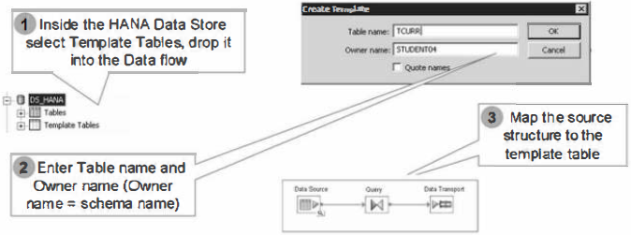
Template Tables
If the structures of the tables are similar or identical to the tables in the source system, then it's not necessary import the meta data prior to executing the Data Services Job.
Data Services provides a Template Tables functionality which executes a SQL statement in the target database prior to the data load which generates the meta data.

Slide 9
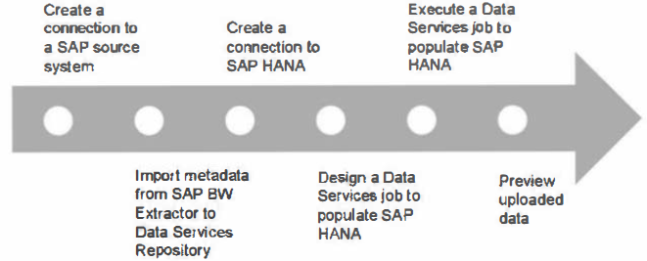
Load SAP ECC data into HANA

Slide 10
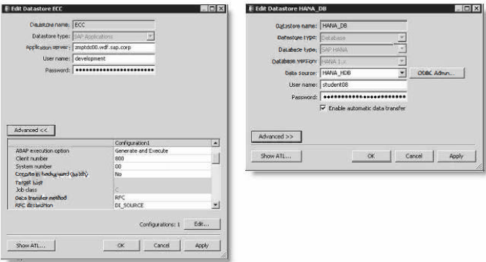
Step 1: Create ECC and SAP HANA Datastores in the Repository

Slide 11
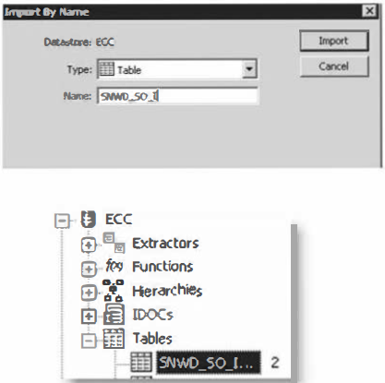
Step 2: Import the ECC Table or Extractor Metadata into the Repository

Slide 12
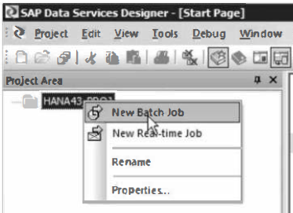
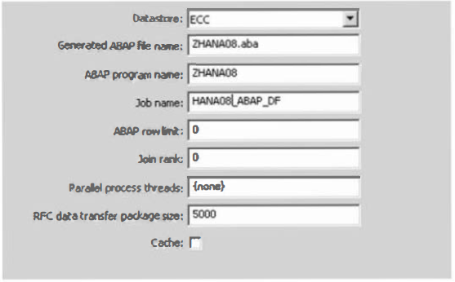
Step 3: Create a Batch Job and Add an ABAP Dataflow
Generated ABAP file name:
Specifies the file name containing ABAP program code that Data Services generates from this SAP ABAP data flow. This file is written t o the directory specified in the datastore definition.
ABAP program name:
Specifies the name Data Services uses for the ABAP program name that runs in SAP ABAP. It must begin with Z and be 8 characters or fewer.
ABAP row limit
Limits the number of rows that will be read by this ABAP data flow. Use this option for testing purposes to limit the time that the parent batch job will run.
Join rank
Determines the order that Data Services reads this data set when joining it with another source. When joining sources, Data Services reads sources with higher ranks before reading sources with lower ranks.
Parallel process threads
Specifies the number of threads that read or load data. This option allows you to parallel process reading and loading For example, if you have four CPUs on your Job Server con1puter, enter the number 4 in this option.

Slide 13
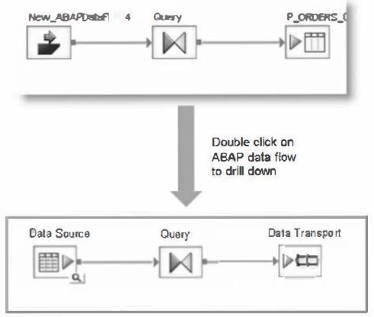
Step 4: Add the ECC Source, Query Transform and Data Transport in the Workspace of the ABAP Dataflow

Slide 14
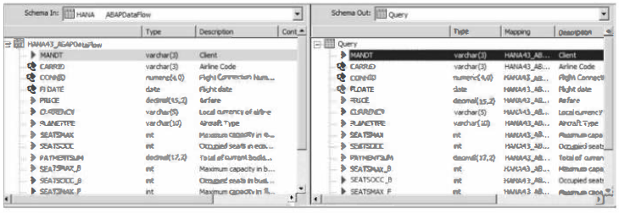
Step 5: Do the Mappings in the Query Transforms

Slide 15
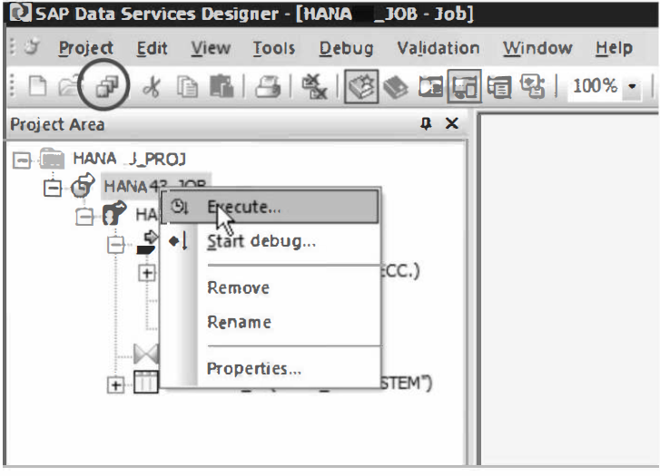
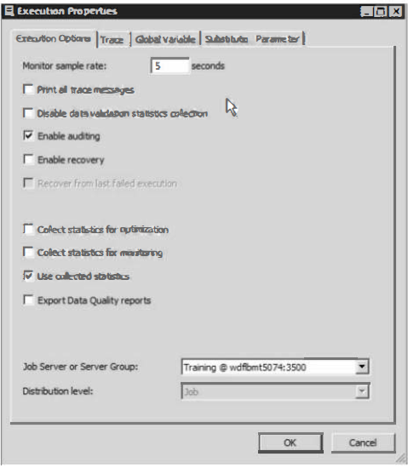
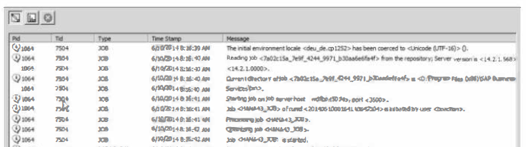
Step 6: Execute the Job and Monitor

Slide 16
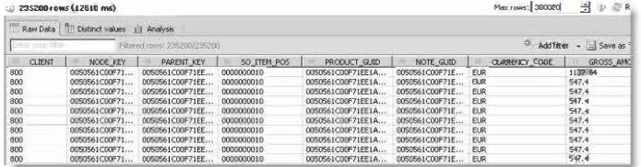
Step 7: Preview Data in SAP HANA

Slide 17
THANK YOU
Courtesy : SAP Labs Document -
HA 350 – Data Provisioning

